Slide 1
Intro. to Management of Business Systems Development
MIS 372 Spring 2022

Slide 2
Learning Objectives
1. Instructor Intro – Zhezhu Wen
2. Syllabus Review
3. Knowledge Structure of the Course
4. QnA

Slide 3
Is Custom Software Development Still Relevant?
Build vs. Buy? That is the question!
“Building” can be still important because…
Companies only want to spend money on the functionality that they need.
The development process is now faster and easier.
New software projects can be expedited, with more pretested code and less bugs than ever before.
Mobile apps can be integrated into the custom software, providing a seamless experience between devices.

Slide 4
Why Building a Software Can be Tricky…
From Sommerville (2020) Engineering Software Products

Slide 5
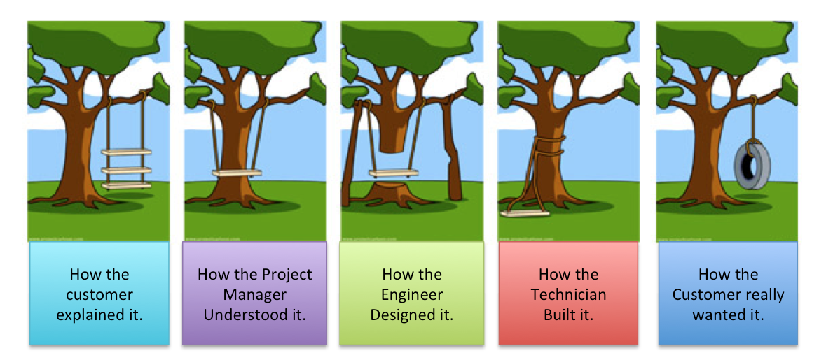
Why Building a Software Can be Tricky… (cont.)

Slide 6
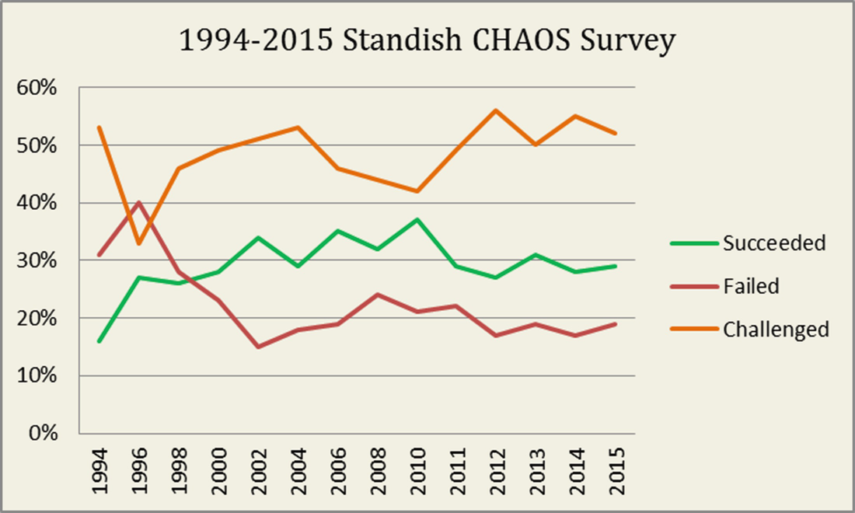
How Often Software Development Projects Go Successfully?
The Standish Group Report

Slide 7
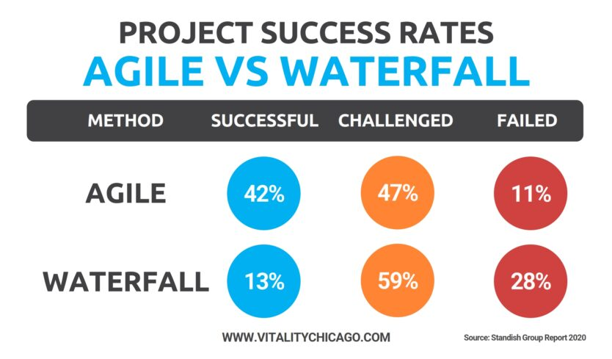
How Often Software Development Projects Go Successfully? (cont.)

Slide 8
Various Perspectives to the Development Process
Software Architect
Product Managers
Business Analysts

